Slide 1

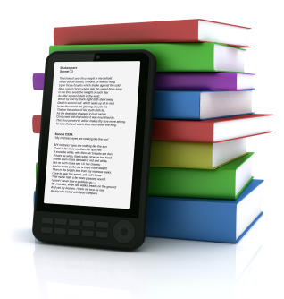
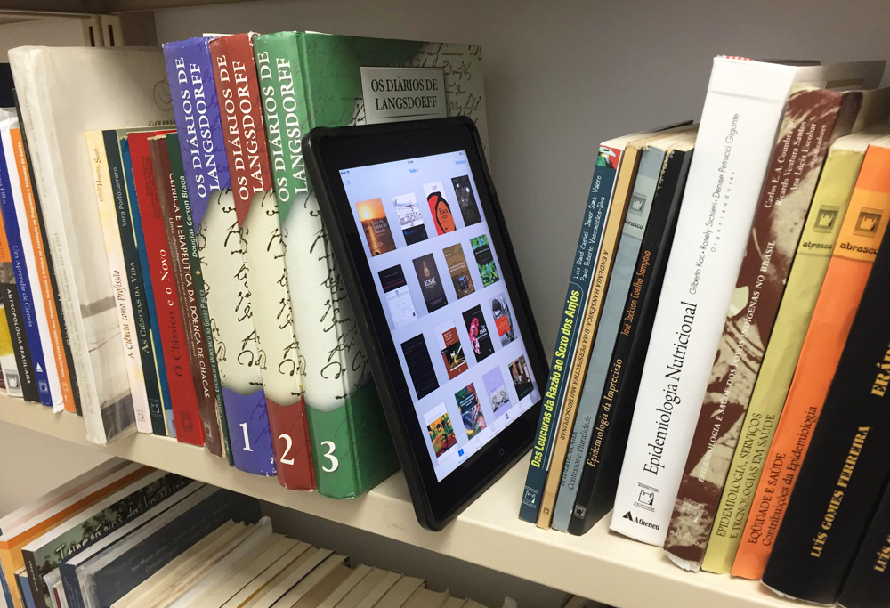
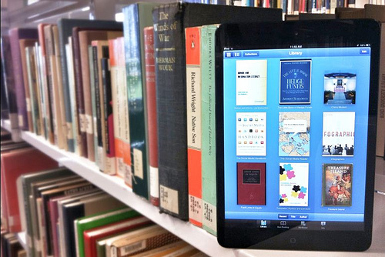
Digital libraries
This Photo by Unknown Author is licensed under CC BY-SA-NC
This Photo by Unknown Author is licensed under CC BY

Slide 2
the emergence of new technologies and user demands has a great impact on the present and future libraries. the format of documents and forms of services has been changing at a very fast speed with the advent of new tools and technology.

Slide 3
The digital library is the most recent term being used for the library without books, libraries having information in electronic format and providing access in digital format.

Slide 4

This Photo by Unknown Author is licensed under CC BY-SA-NC

Slide 5
Meaning of digital libraries
DIGITAL LIBRARY ARE THOSE LIBRARIES WHICH ARE FULLY AUTOMATED AND ALL RESOURCES ARE IN DIGITAL FORM AND THE ACCESS TO THE INFORMATION AVAILABLE IS PROVIDED TO A REMOTE USER AS WELL AS CONVENTIONAL USER ELECTRONICALLY.

Slide 6
CHARACTERISTICES OF DIGITAL LIBRARY
THE STORAGE OF INFORMATION IN DIGITAL FORM.
USAGE OF COMMUNICATION NETWORKS TO ACCESS AND OBTAIN INFORMATION.
COPYING EITHER BY DOWNLOADING OR ONLINE/OFFLINE PRINTING FORM MASTER FILE.

Slide 7
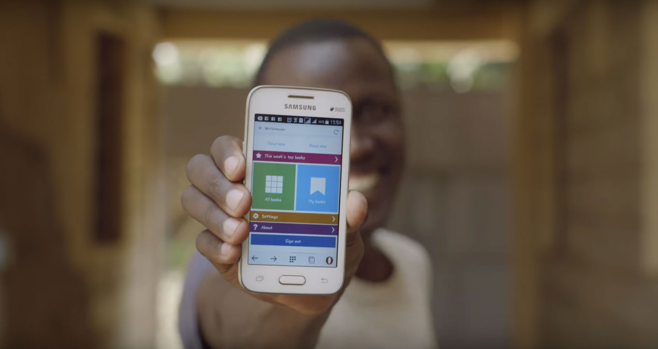
Our ideas about the digital libraries
We have made a project. Our aim is to create an e-library which have the given configuration:-
It will search books by author names, book titles, and its id.
There is an option to add in favorites. And then you will be able to search your favorites book.
There should be list of suggested books according to your flavour or by your previous surfing.
There will be stars rating for it which will help us to judge you about interest.
This Photo by Unknown Author is licensed under CC BY-NC-ND

Slide 8
FUNCTIONs OF DIGITAL LBRARIES
PROVIDE ACCESS TO A VERY LARGE INFORMATION COLLECTION.
SUPPORT MULTIMEDIA CONTENT.
PROVIDE USER FRIENDLY INTERFACE.
SUPPORT ADVANCE SEARCH AND RETRIEVAL.

Slide 9
CONCLUSION
IN SHORT WE CAN SAY THAT DIGITAL LIBRARIES CAN SAVE THE TIME AND MONEY OF THE SOCIETY BY IT’S SERVICES.WE CAN USE THIS TIME AND MONEY IN OTHER DEVELOPMENTAL WORK.SO DIGITAL LIBRARIES PLAY A MAJOR ROLL IN THE DEVELOPMENT OF A COUNTRY.

Slide 10

This Photo by Unknown Author is licensed under CC BY-SA

